Slide 1

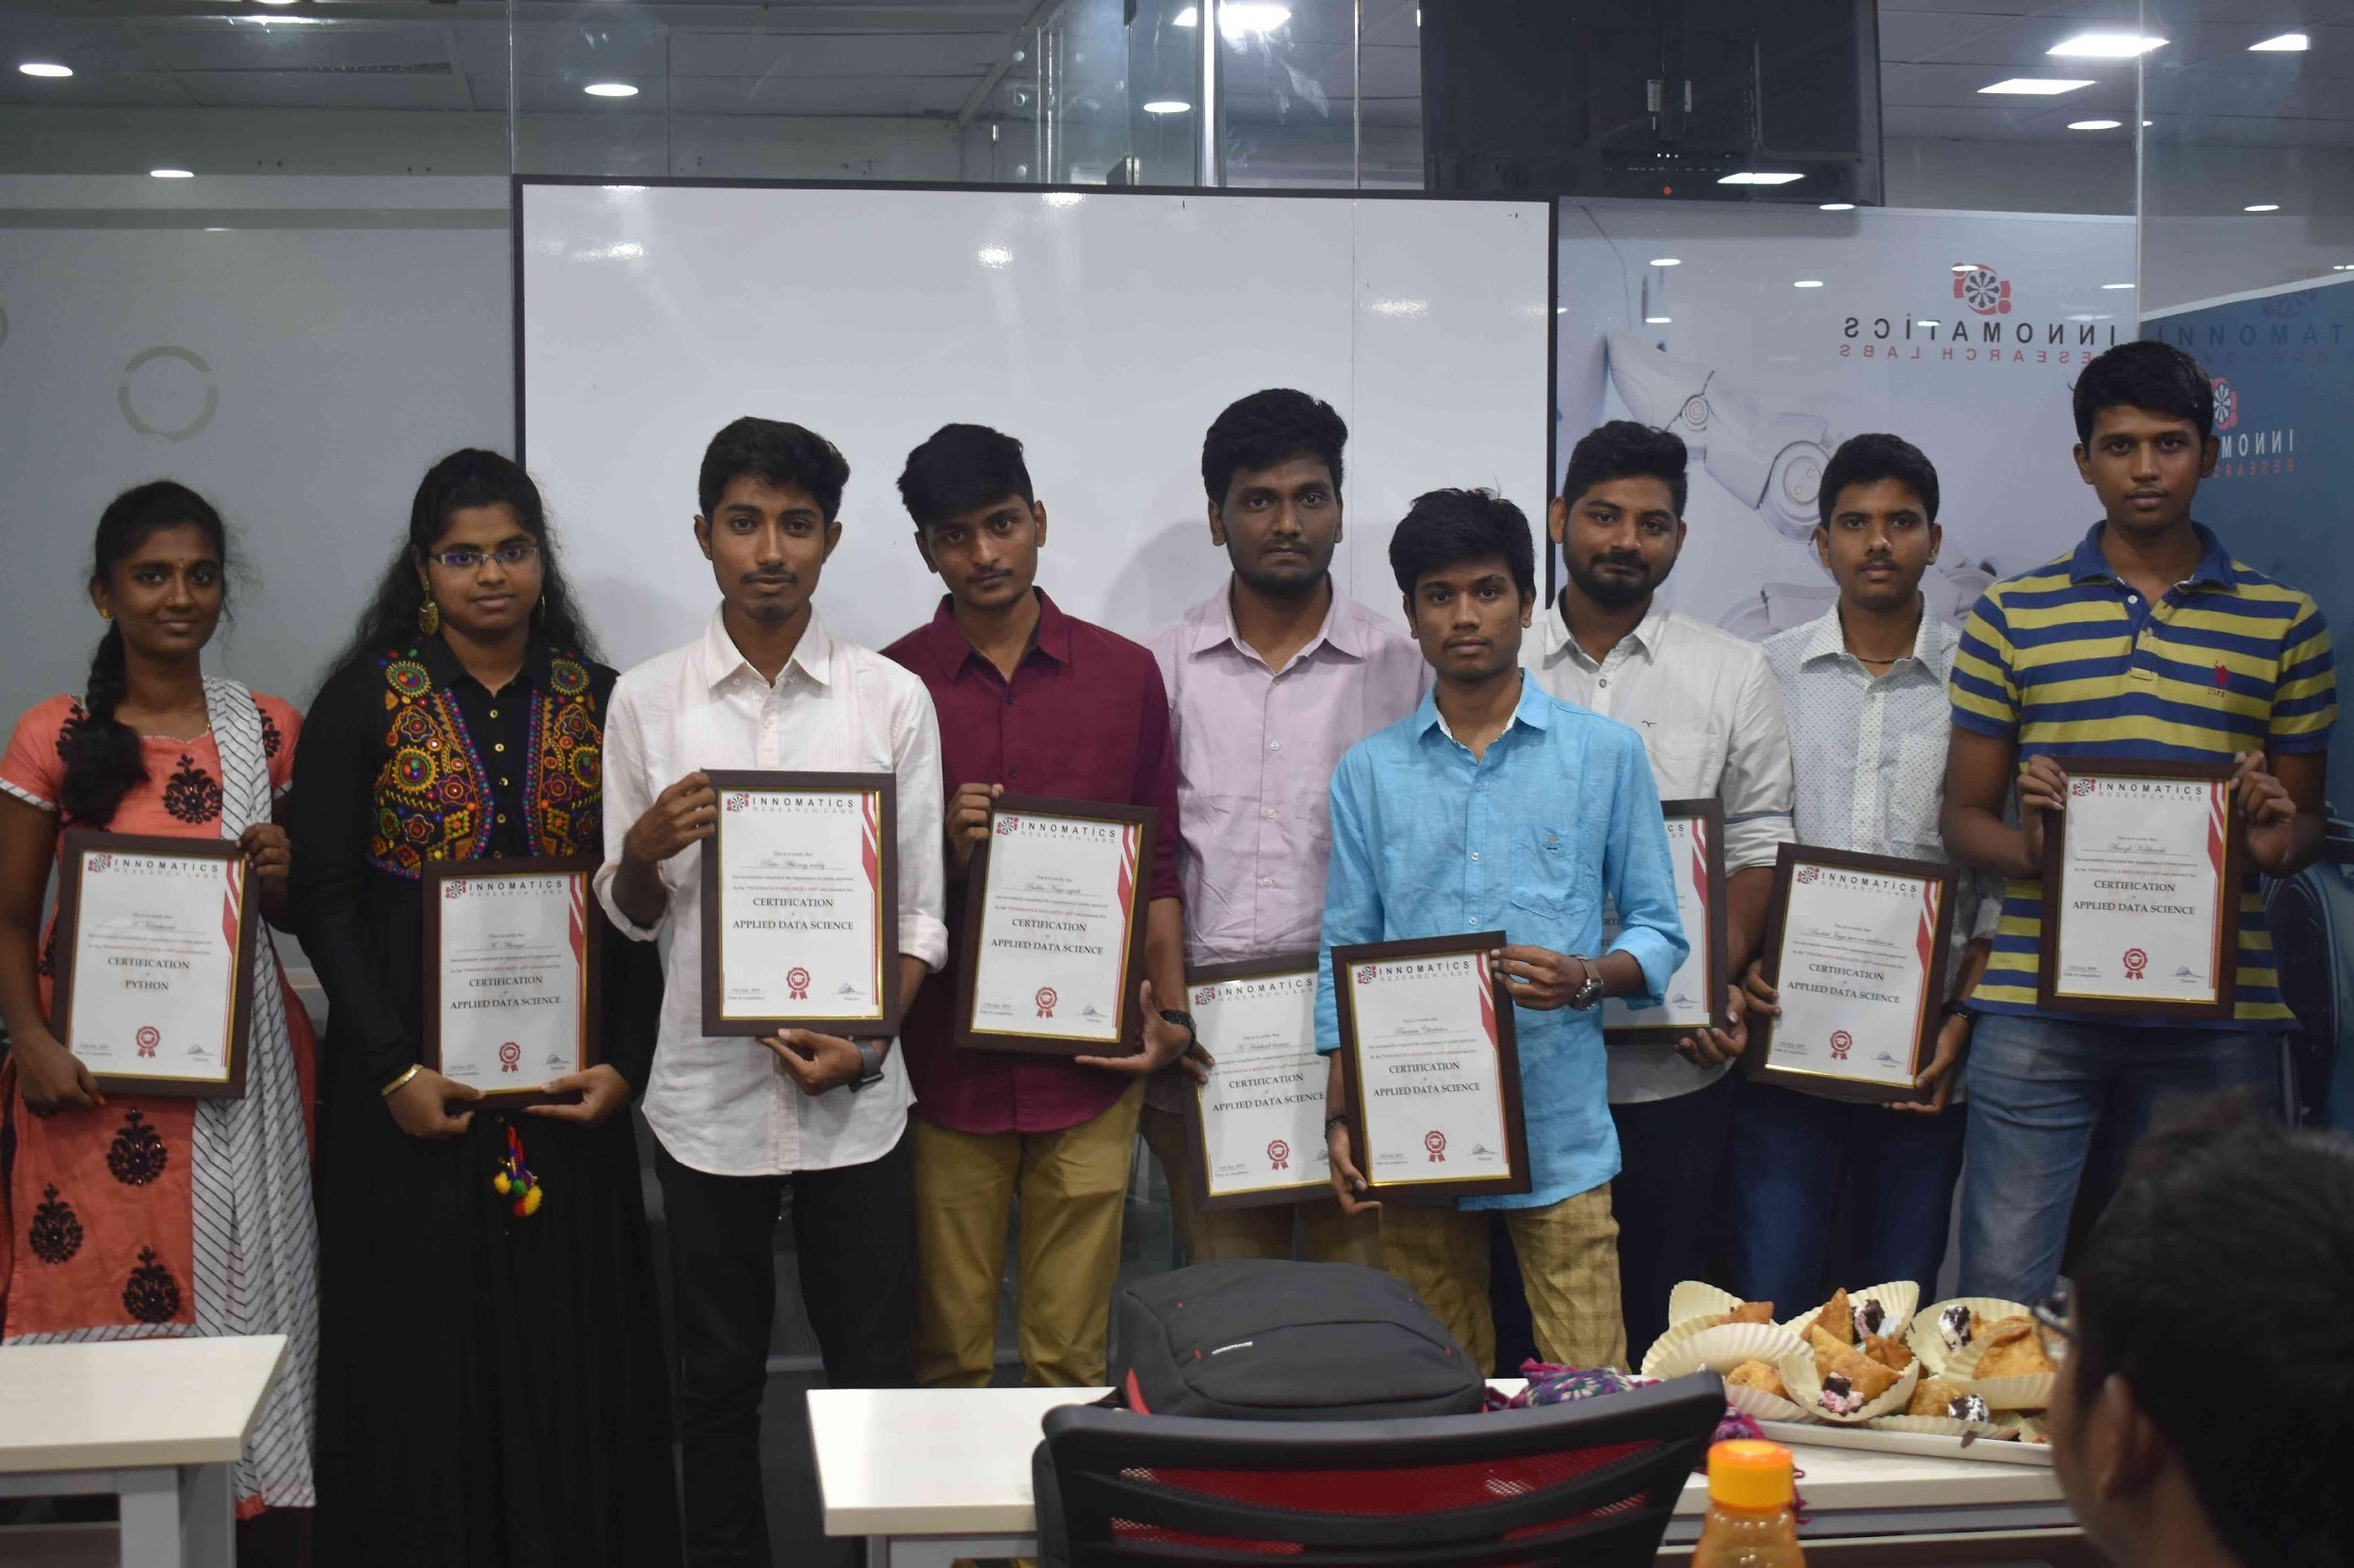
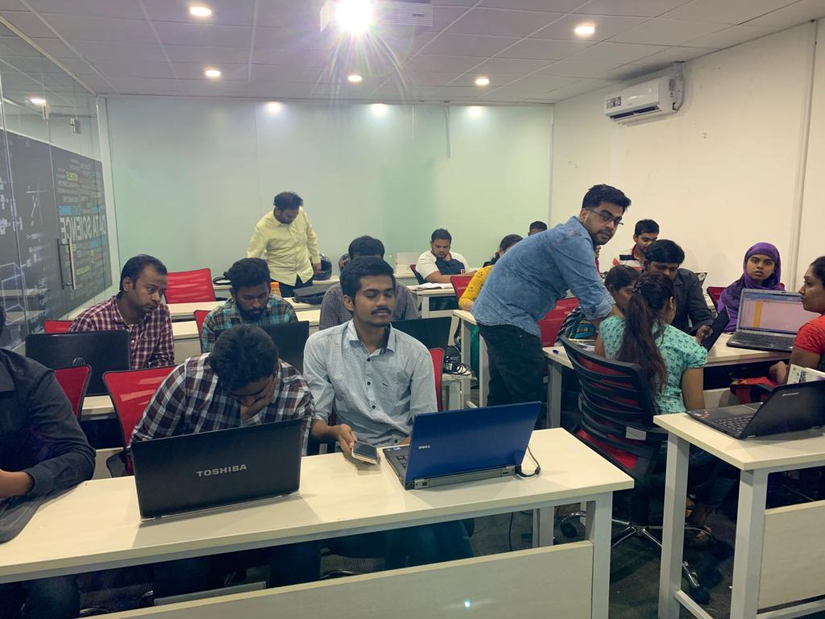

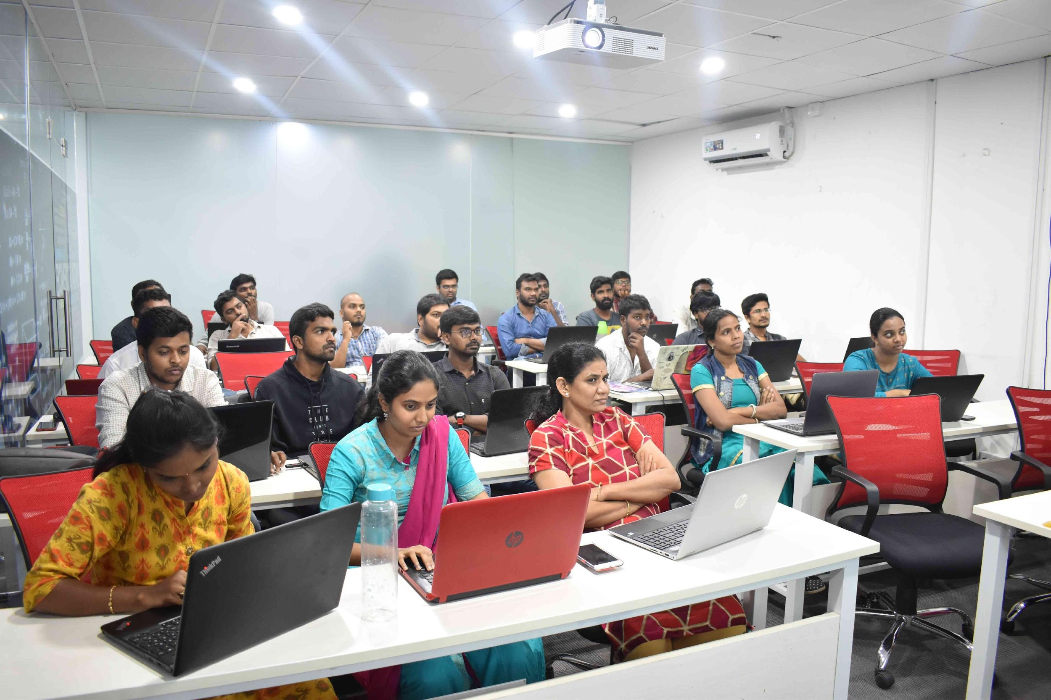
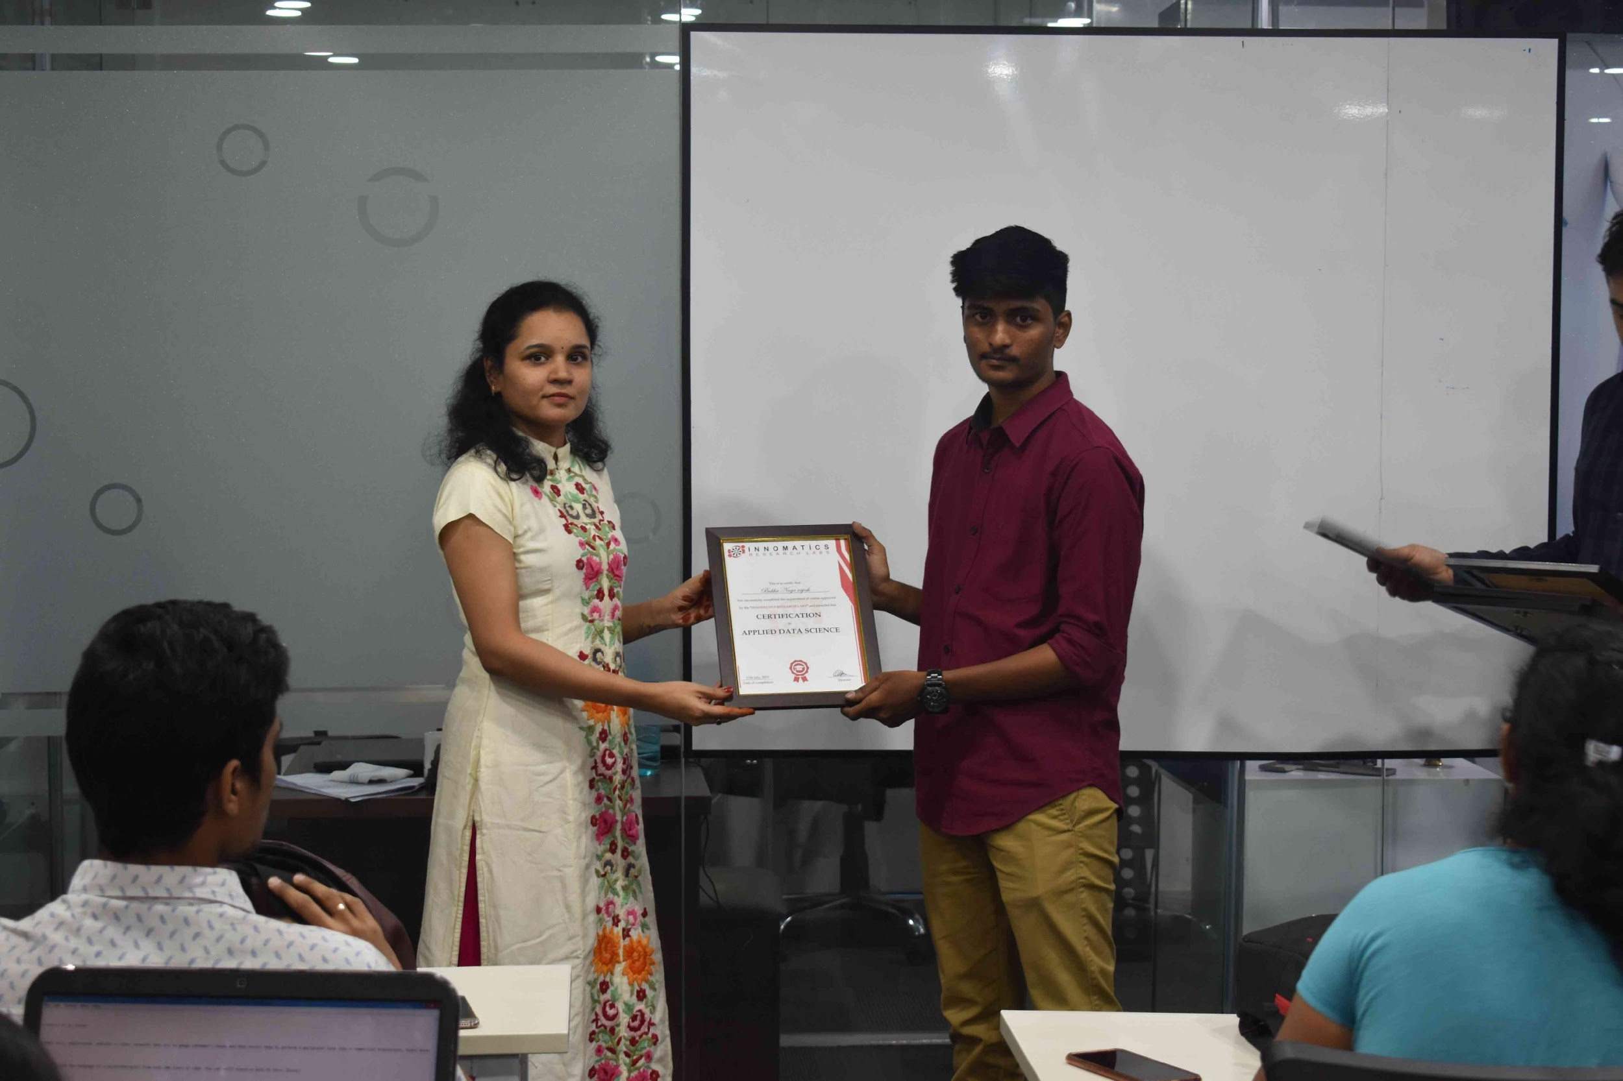
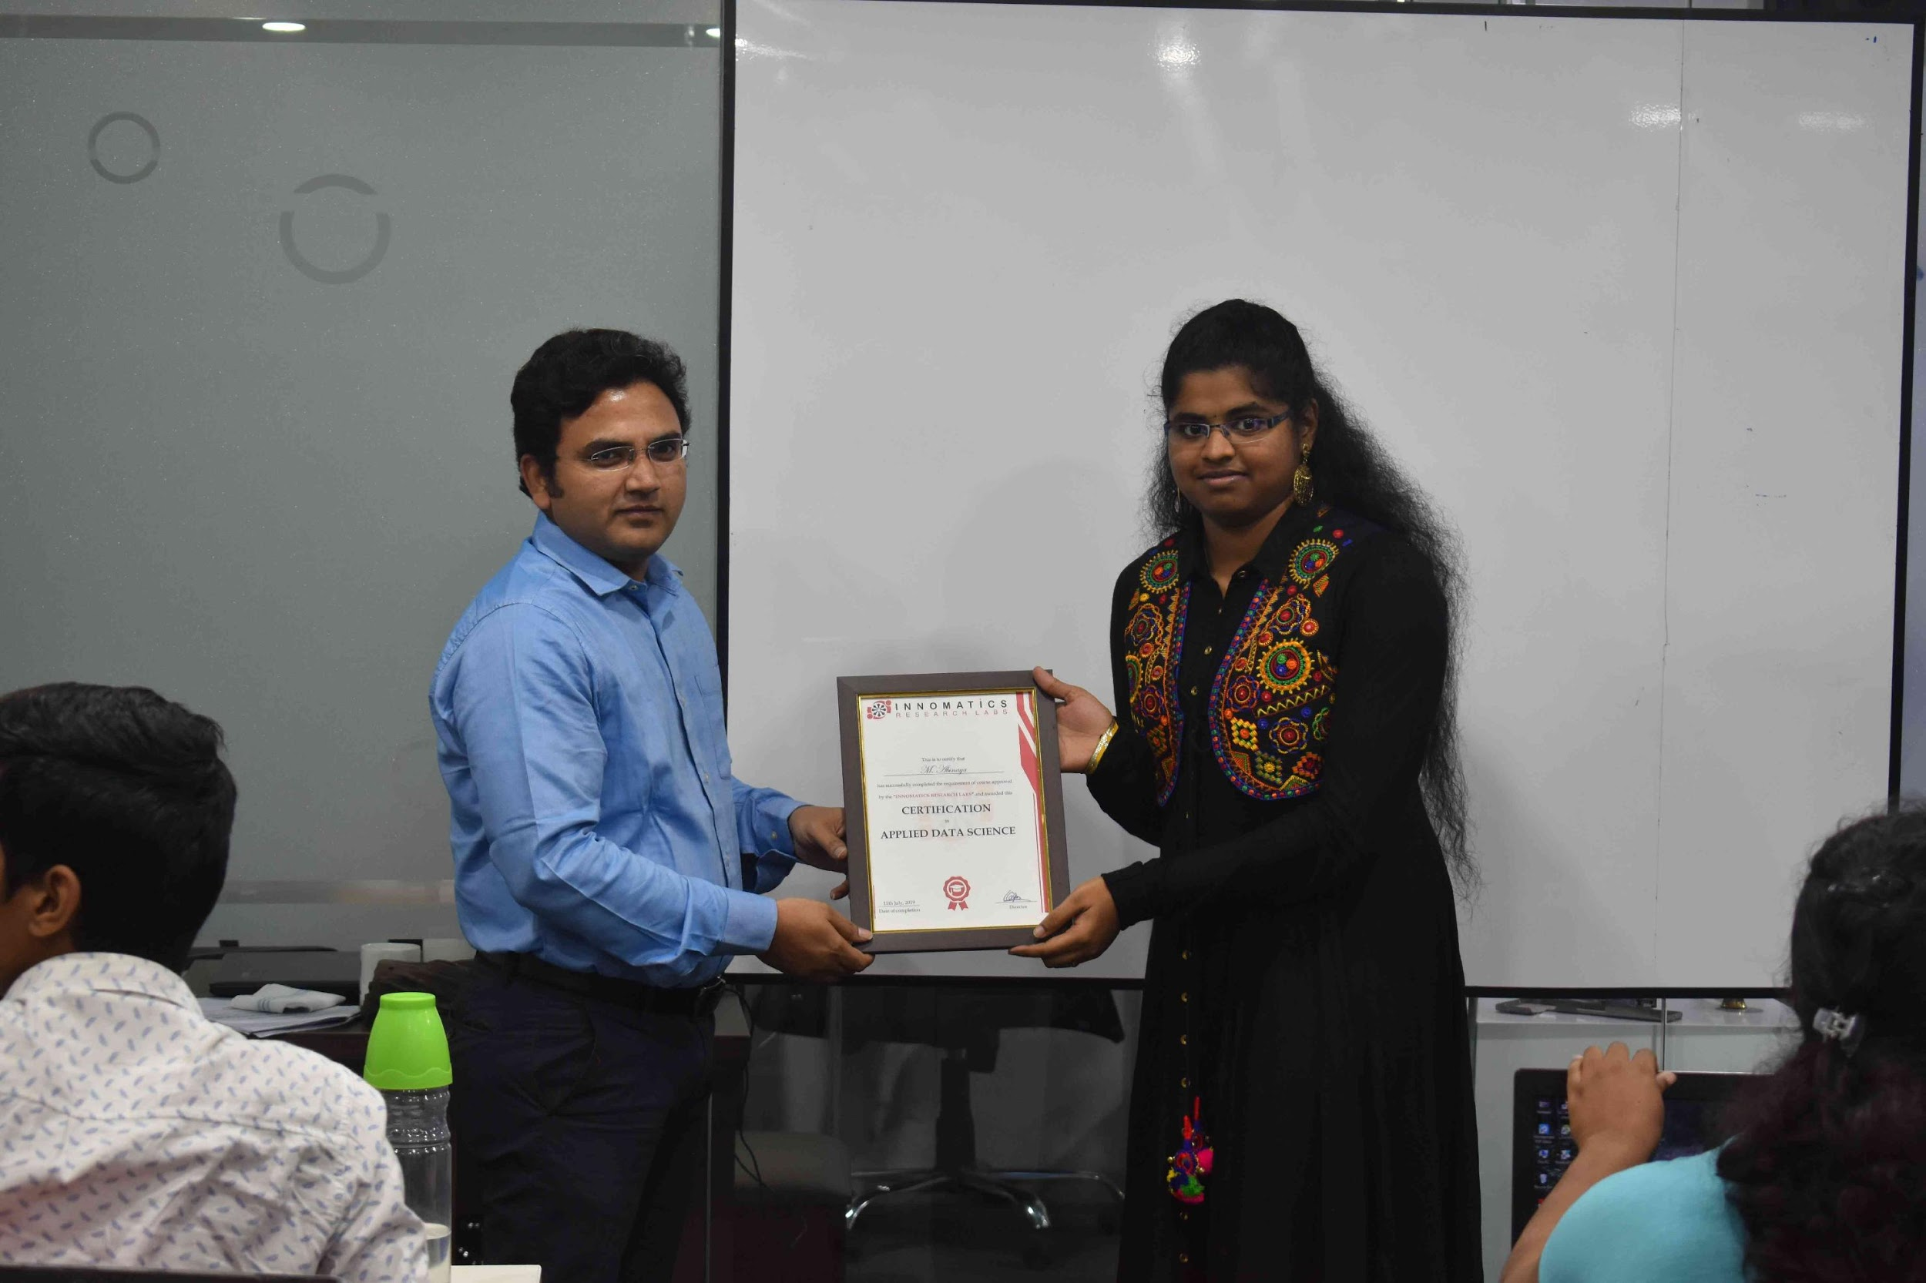

Slide 2

DATA ANAYLSIS ON USED CARS USING CARSOME
SAI KRISHNA KONKUMUTTI
HAREG BUNKER

Slide 3
ABOUT ME
HAREG BUNKER
SAI KRISHNA KONKUMUTTI
Educational Background
Bachelor in Engineering (Mechanical Engineering)
Why you want to learn Data Science
Unable to contribute 100% of potential working in core automobile industry
Explore different career option - started coding - gets interest in solving numerical problem by using coding
Enjoy Problem solving and statistical analysis
Work Experience
Worked 1 year in automobile industry
NSSl Neco Group (FVD) Nagpur
Gestamp Automotive India Pune
Educational Background
Bachelor of Technology (Mechanical Engineering)
Why you want to learn Data Science
Unable to contribute 100% of potential working in core automobile industry
Explore different career option - started coding - gets interest in solving numerical problem by using coding
Enjoy Problem solving and statistical analysis
Work Experience
Worked in CYIENT for 1 year 3 months on GIS PLANNER(Utilites and Telecommuncation)

Slide 4
BUSINESS PROBLEM
Based on the current covid situation, many people has gone to financial crisis.
People are considering more used cars than new cars.
So, we decided to do data analysis on used cars.
In this project, we have extracted data from carsome website.

Slide 5
OBJECTIVE OF THE PROJECT
To analyzes the cars data with using any relevant website.
To do analysis on cars with respect to their price , year , km driven and other features.
To recommend the aspiring car buyer the best cars as per their requirement.

Slide 6
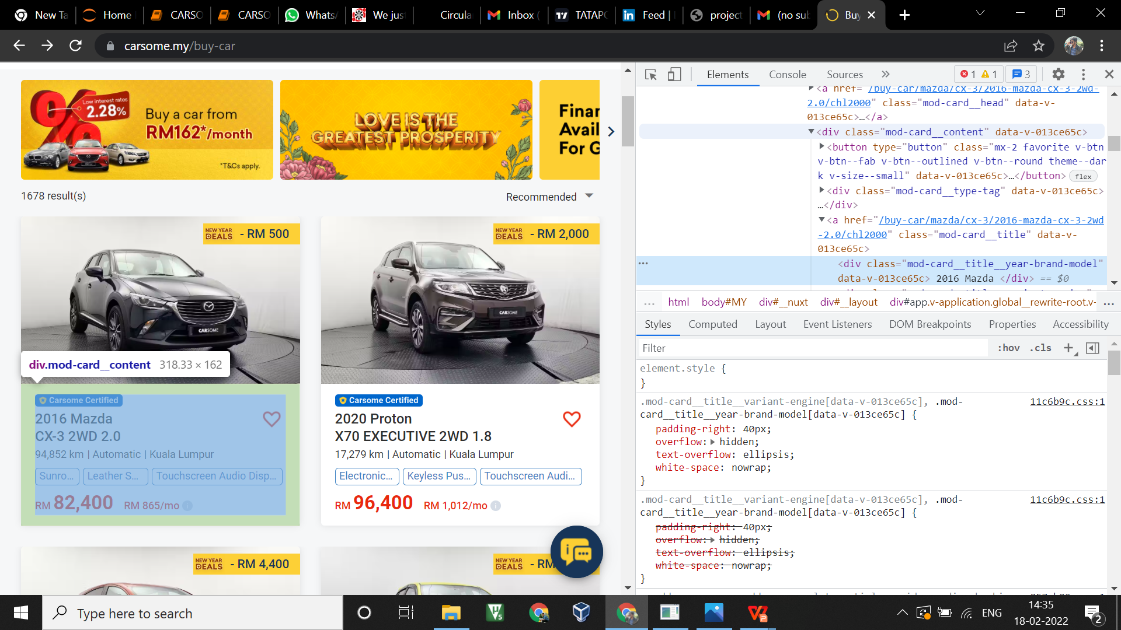
WEBSITE

Slide 7
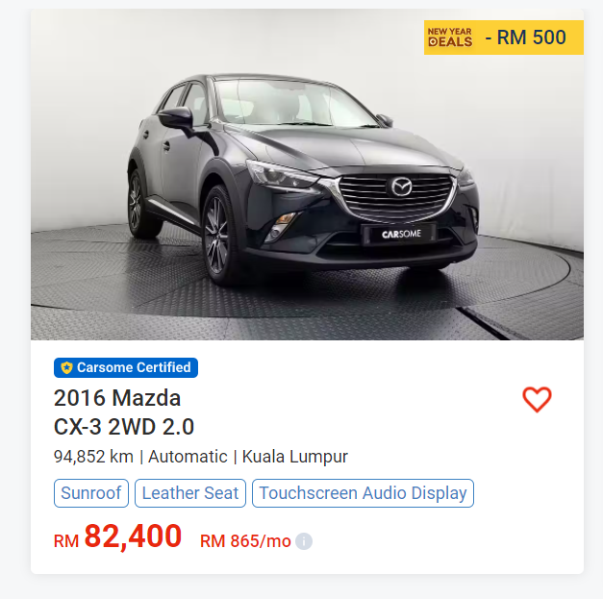
CARS DETAILS
CARS NAME
MODEL NAME
LOCATION
YEAR
PRICE
TRANSMISSION TYPE
FEATURES

Slide 8
WEB SCRAPING
Imported important libraries
Assign the variable to website url
Requested the url to access the data
Extract the details and converted into csv
Applied BeautifulSoup
converted into text assigning variable

Slide 9
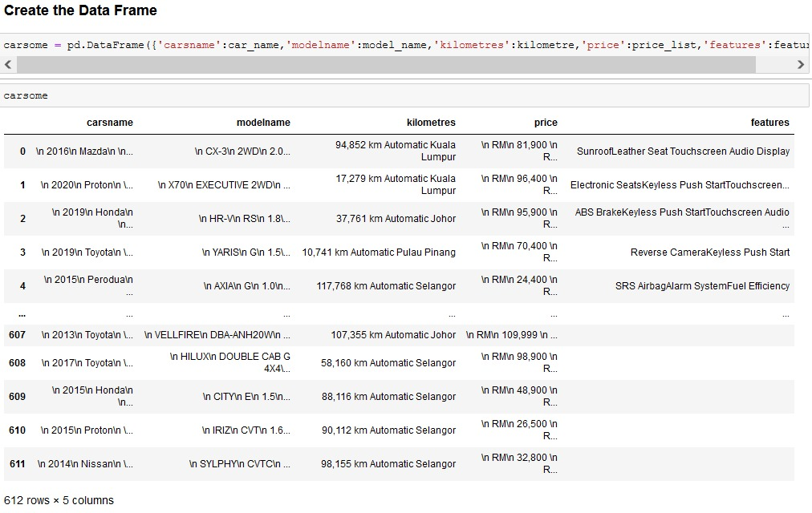
SUMMARY OF THE DATA

Slide 10
DATA CLEANING
Identifying Null Values.
Identifying Missing Values.
Treating rows and columns with null values and missing values.
Categorical data will be fill with mode and numerical and float data will be fill with mean and median.
Converting required columns from object to int or float datatype.
Drop unwanted columns.

Slide 11
DATA MANIPULATION
Data manipulation is the of organizing data to make it easier to read.
We have used split() and append() functions to manipulate the data.
By using Regular Expression(RegX) we can manipulate the data.
Replacing the unnecessary data with the spaces.

Slide 12
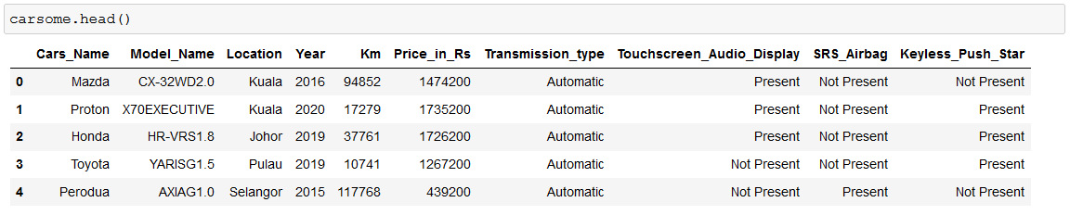
DATAFRAME AFTER DATA CLEANING AND MANIPULATION

Slide 13
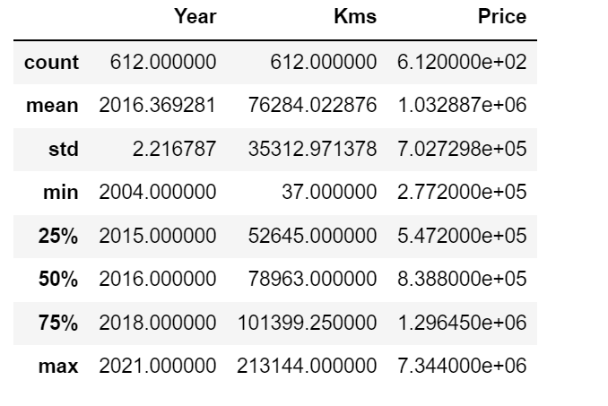
STATISTICS OF DATAFRAME
Cars Price in Rs
Cars Price in Rs is on an average 10 lakhs.
Price in Rs of cars is minimum and maximum 2 lakhs approx and 73.4 lakhs approx respectively.
Most of the cars in Price in Rs range of 5.5 to 13 lakhs
Car Driven in Km
Most of the cars driven for 76 Thousand km.
Smallest driven car is 37 km and longest driven car is 2 lakhs km.
Most of the cars driven in between a range of 52 Thousand km to 1 lakhs km.
Year
Most of the cars from 2016.
Oldest car is from 2004 and newest car is from 2021.
Most of the cars is between a range of 2015 to 2018.

Slide 14
Univariate Analysis

Slide 15
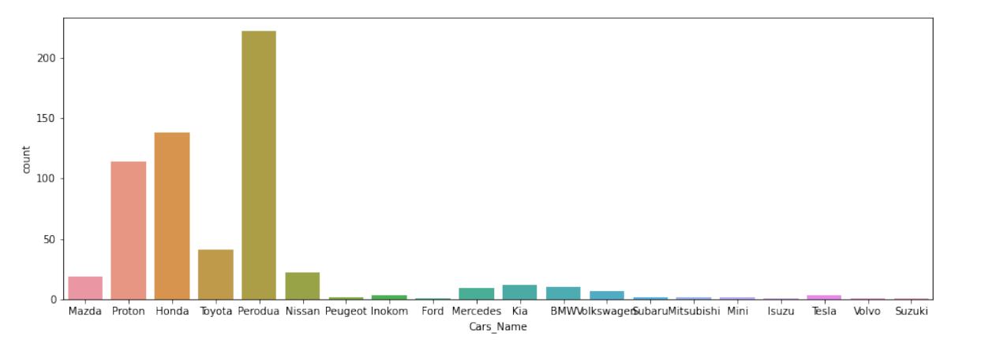
VISUALISING BRAND WISE
OBSERVATION:
In this plot, Perodua brand cars are more available compared to other brands
Most of available cars Perodua, Honda, Proton are more available
Ford, Isuzu, Volvo, Suzuki are least available
Most of the cars are less than 50

Slide 16
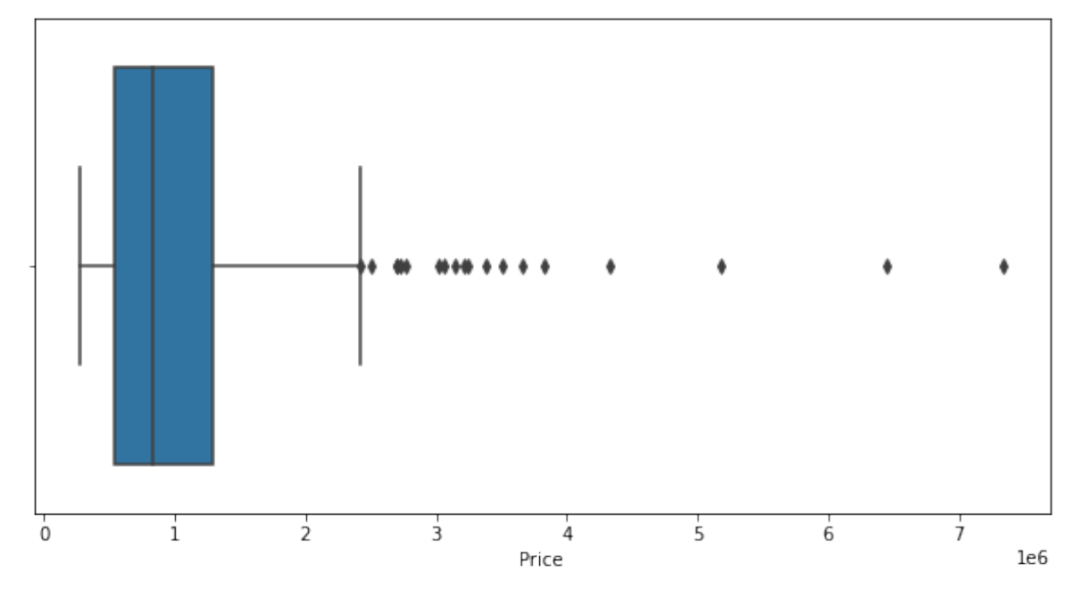
VISUALISING PRICE WISE
OBSERVATION:
Most of the cars are range between 500000 to 1400000
Cars in range of 2500000 to 7500000 are outliers

Slide 17
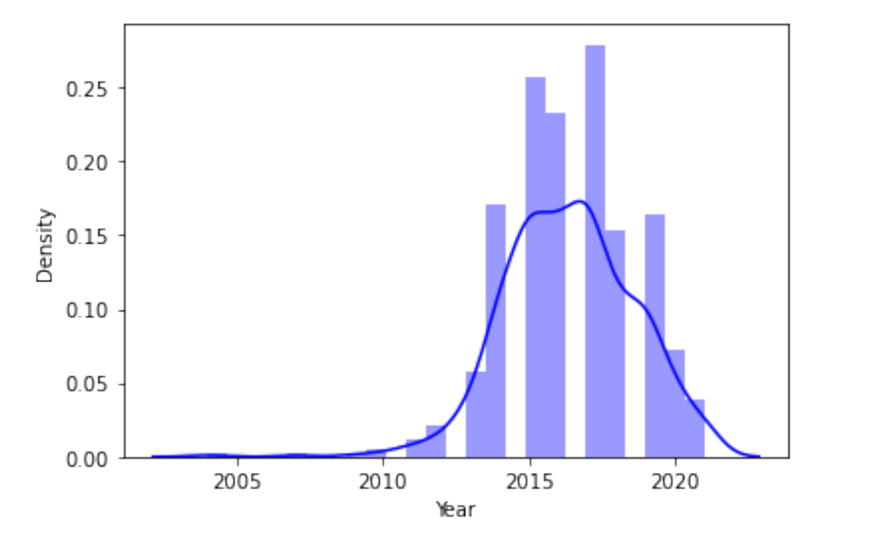
VISUALISING YEAR WISE
OBSERVATION :
Most of the cars are ranges between 2014 to 2019.
Most of the cars are in 2017
Least cars are from 2004 to 2012.

Slide 18
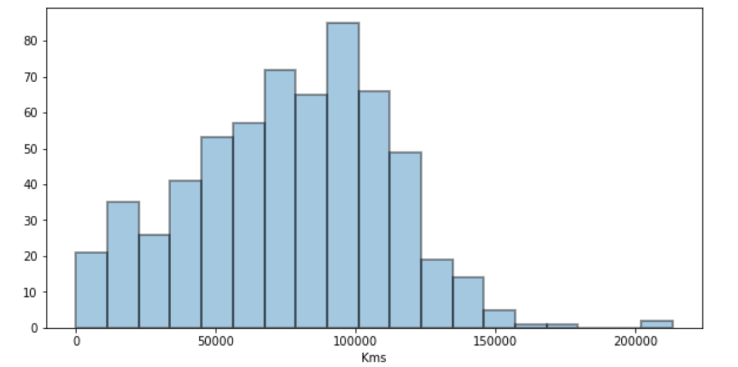
VISUALISING KM WISE
OBSERVATION :
Most of the cars are ranges between 50000 km to 120000 km
Less cars are ranges between 150000 km to 200000 km

Slide 19
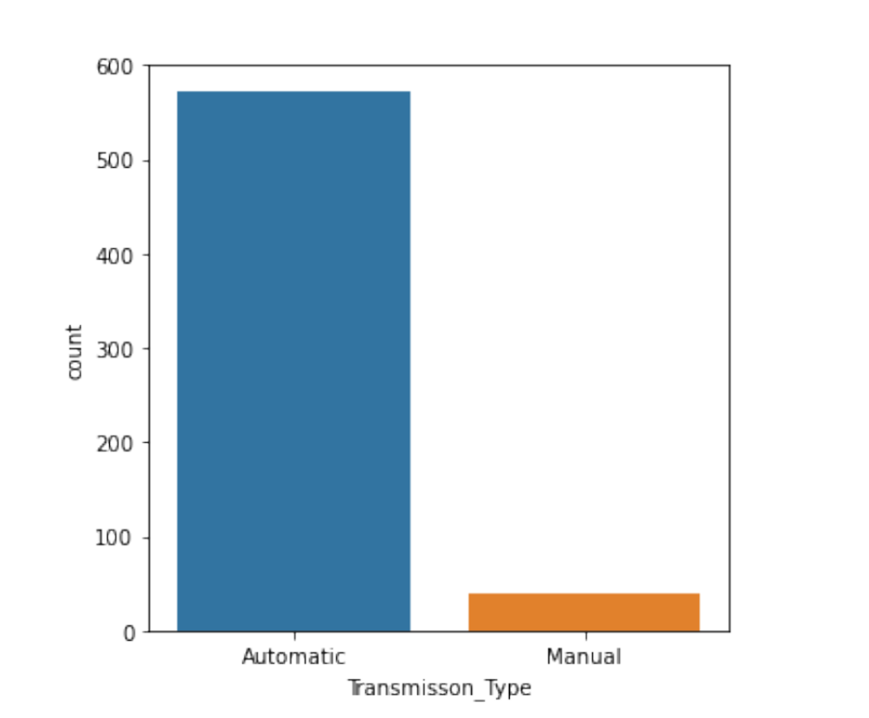
VISUALISING TRANSMISSIONTYPE WISE
OBSERVATION :
Most of the cars are automatic transmission type
Less cars are manual transmission type

Slide 20
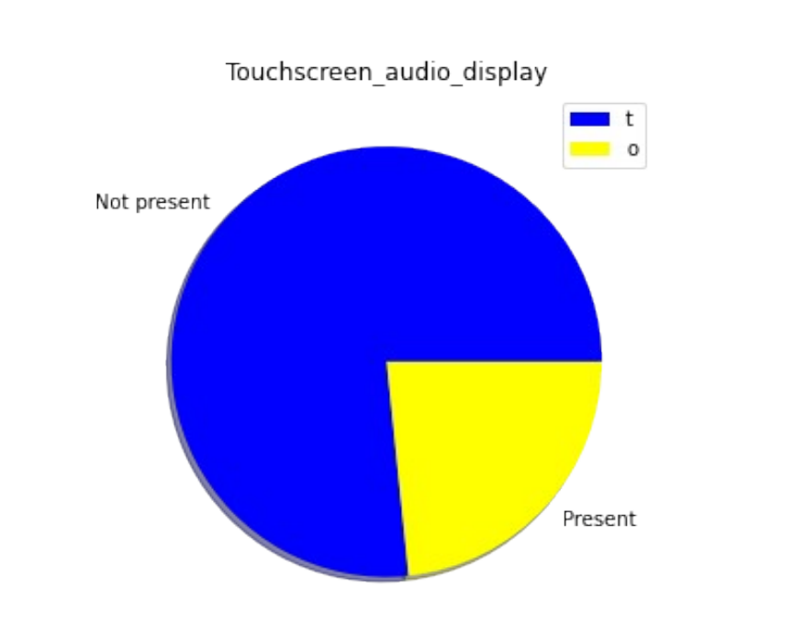
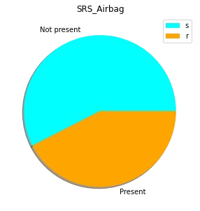
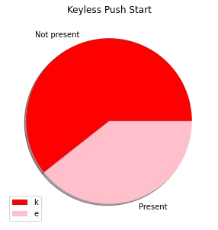
VISUALISING FEATURES IN CARS
OBSERVATION :
Most of the cars touchscreen audio display is not present.
Most of the cars SRS airbag is not present.
Most of the cars keyless push start is not present.

Slide 21
BiVariate Analysis

Slide 22
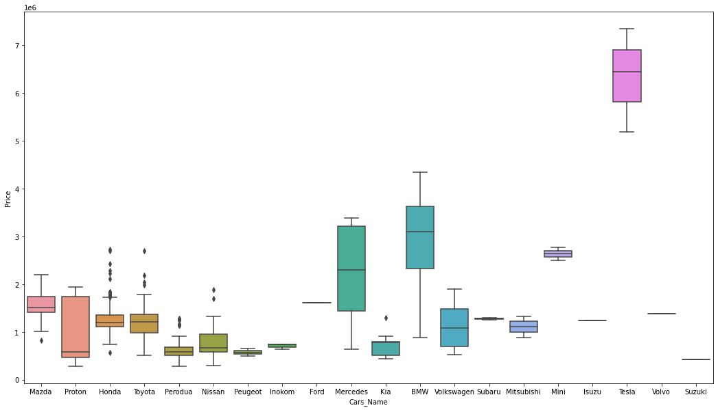
COMPARING CARS WITH PRICE
OBSERVATION :
Tesla cars are more expensive compare to other cars
Suzuki, Proton, Perodua and Nissan are less in prices
Proton, Mercedes, BMW and Volkswagen gives varieties of cars with respect to price

Slide 23
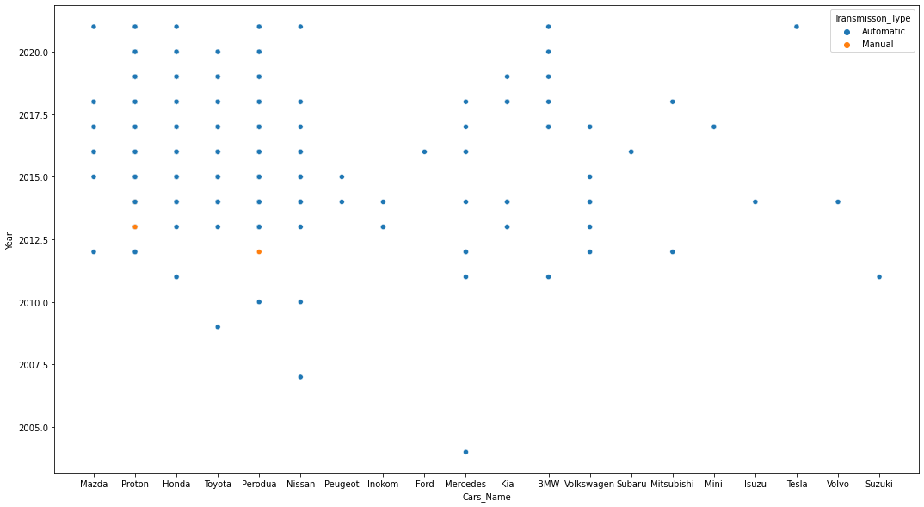
COMPARING CARS WITH YEAR
OBSERVATION :
Most of cars are range between 2010 to 2020.
Most oldest car is Mercedes from 2004
Most newest car are Mazda, Proton, Honda, Perodua, Nissan, BMW and Tesla from 2021

Slide 24
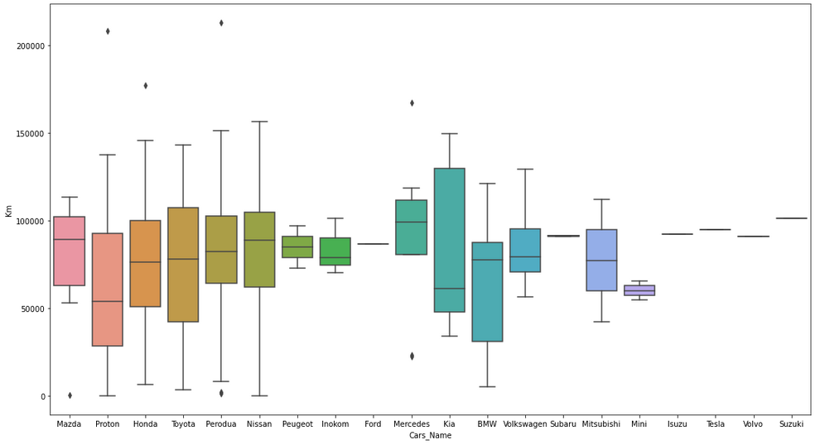
COMPARING CARS WITH KM
OBSERVATION :
Most of the cars are driven Between 50000 To 120000 Km.
Perodua Cars Driven More In Kilometres
Proton Cars Driven Less in Kilometres

Slide 25
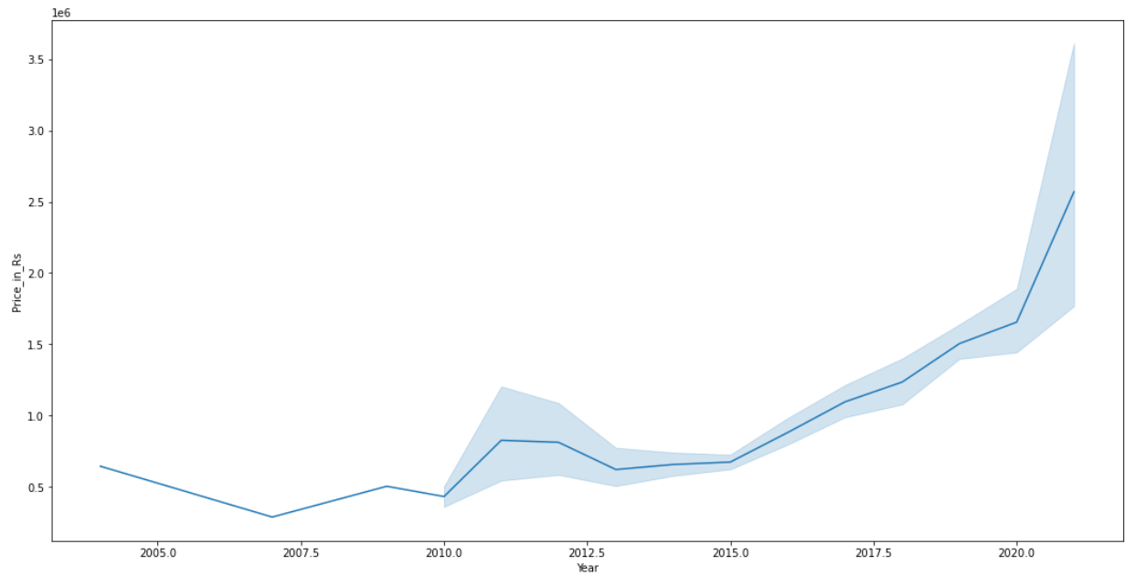
COMPARISION YEAR AND PRICE
OBSERVATION :
As the year of car increases the price of the car increases.

Slide 26
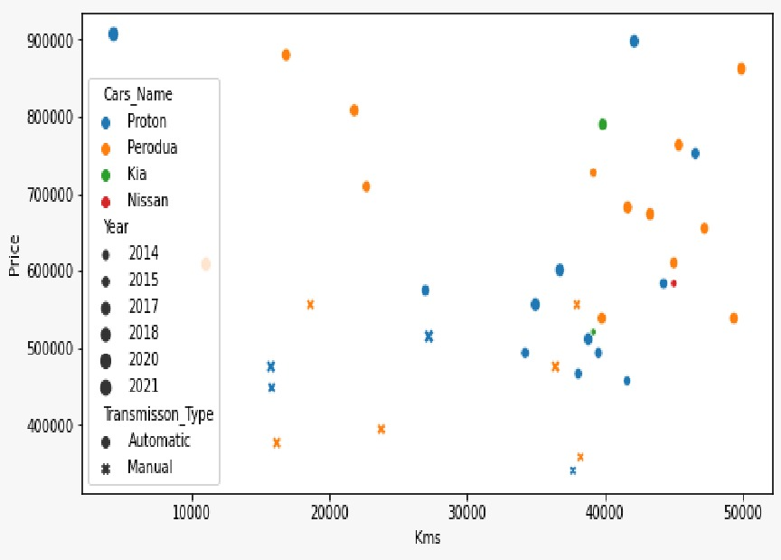
Key Business Question :
OBSERVATION :
Proton, Perodua, Kia and Nissan are available between 500000 to 1000000 prices.
Proton and Perodua has wide range of cars
Most of the cars are from 2018, 2020 and 2021
Nissan cars are least.
Kia is the oldest car.
Manual cars are mostly less than 600000

Slide 27
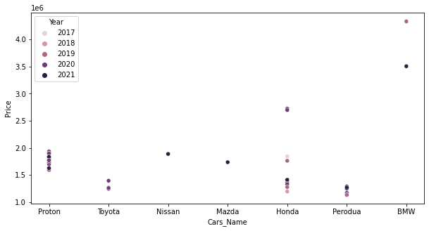
OBSERVATION :
Proton, Perodua, Honda, BMW, Nissan, Mazda and Toyota are available between 2017 to 2021
BMW cars are more expensive
Proton and Honda gives wide range of cars

Slide 28
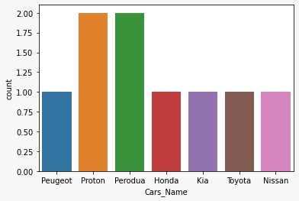
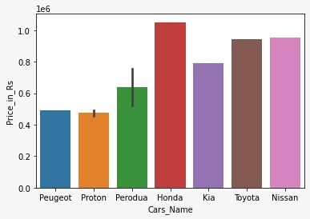
OBSERVATION :
Proton and Perodua has wide range of cars in which Keyless push start and SRS Airbag are present.
Honda, Toyota and Nissan are more expensive than other cars

Slide 29
CONCLUSION
Most of the cars in Price in Rs range of 5.5 to 13 lakhs. Price in Rs of cars is minimum and maximum 2 lakhs approx i.e Suzuki and 73.4 lakhs approx i.e Tesla cars respectively.
Most of the cars driven in between a range of 52Thousand km to 1lakhs km. Smallest driven car is 37 km i.e Proton Cars and longest driven car is 2 lakhs km i.e Perodua Cars.
Most of the cars is between a range of 2015 to 2018. Oldest car is Mercedes from 2004. Newest car are Mazda, Proton, Honda, Perodua, Nissan, BMW and Tesla from 2021.
Most of the cars are automatic transmission type.
Most of the cars touchscreen audio display is not present.
Most of the cars SRS airbag is not present.
Most of the cars keyless push start is not present.
Perodua brand cars are more available compared to other brands.
Perodua, Ford, Isuzu, Volvo, Suzuki are least available.

Slide 30
Q&A Slide :

Slide 31

THANK YOU

